Slide 1

On & Off-Page SEO HW
ca.livinglibations.com

Slide 2
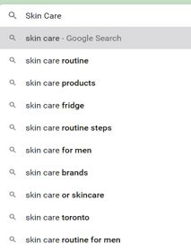
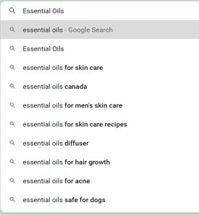
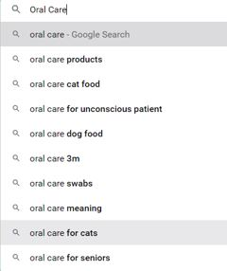
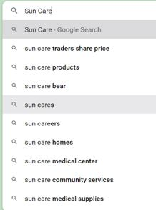
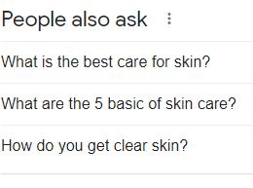
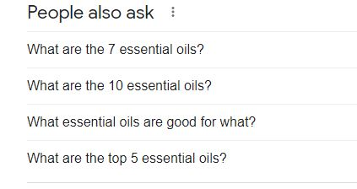
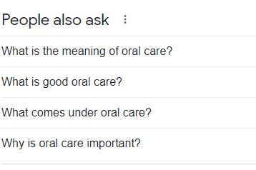
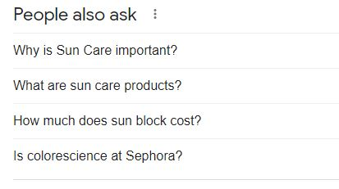
Google Autocomplete & People also Ask

Slide 3
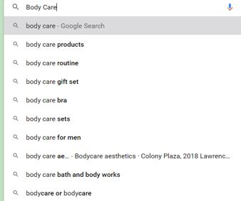
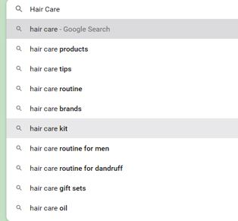
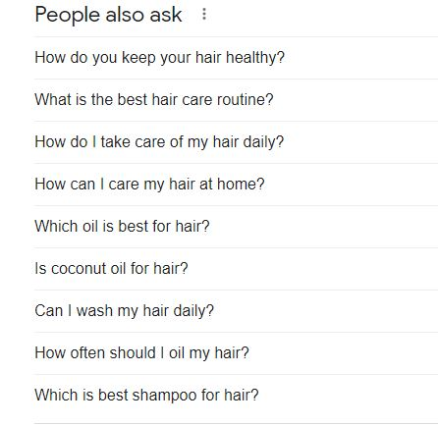
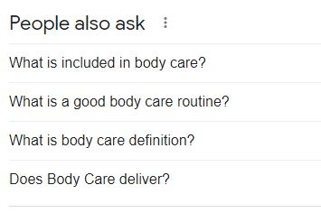
Google Autocomplete & People also Ask (Cont.)

Slide 4
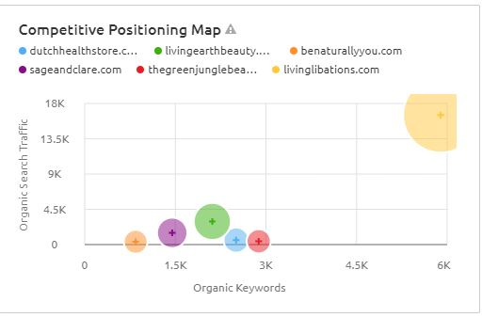
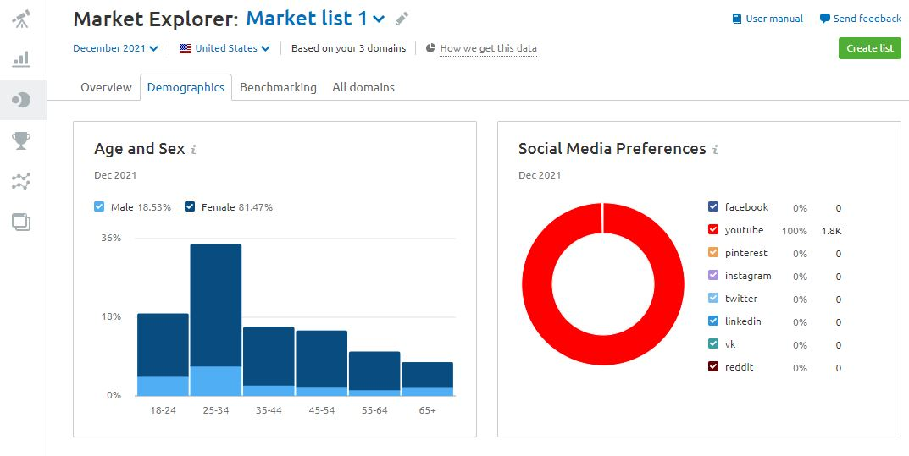
Competitors & Audiences

Slide 5
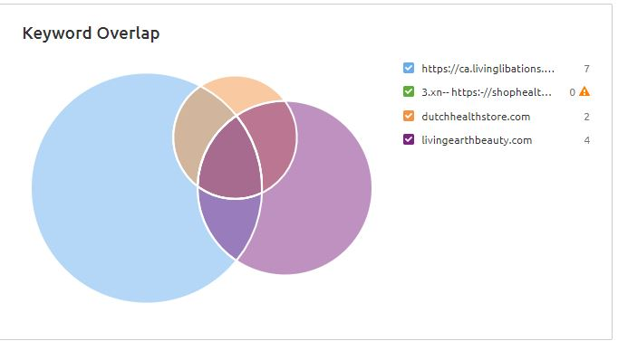
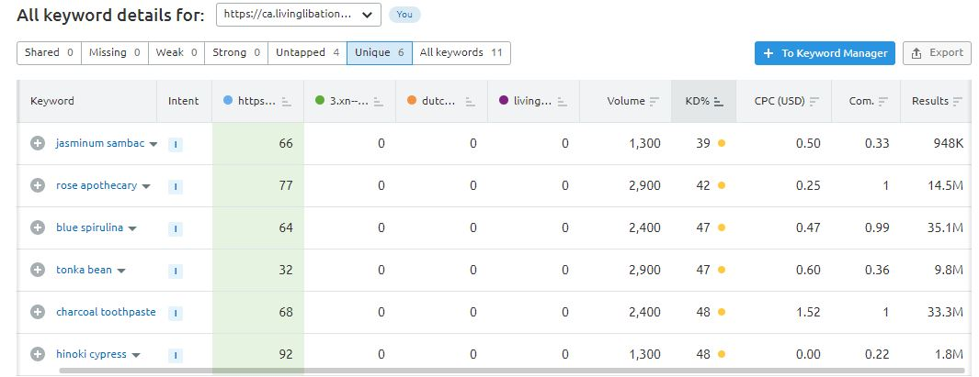
Competitors Keyword Analysis
After reviewing the graph, I noticed that there are 06 unique keywords within the 11 keywords. Living libations contains 07 keywords that are matched in the other three rivals.

Slide 6
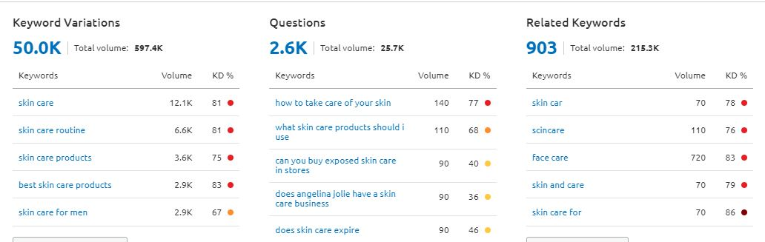
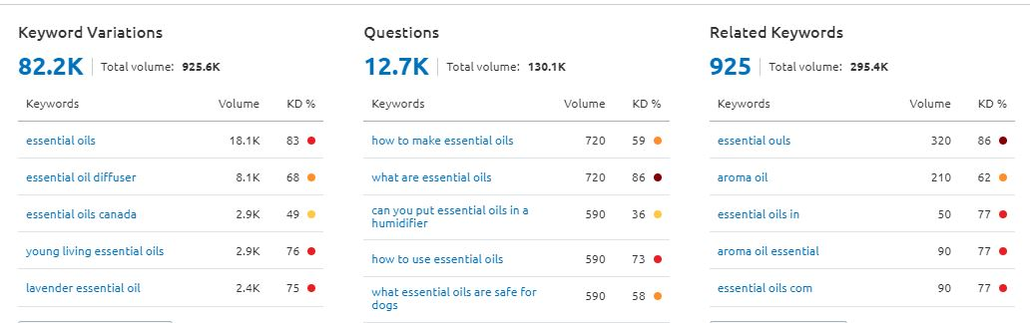
Short-Tail & Long-Tail Keywords
Skin Care
Essential Oil

Slide 7
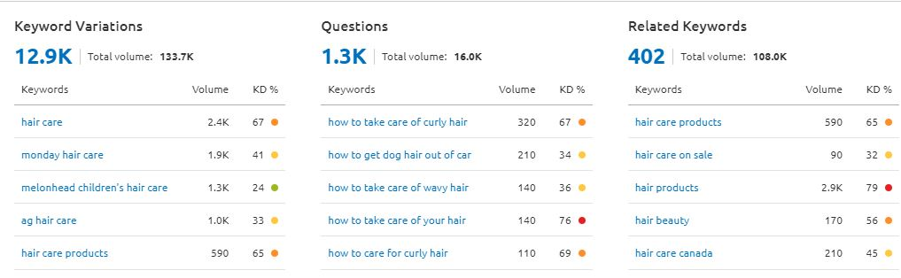
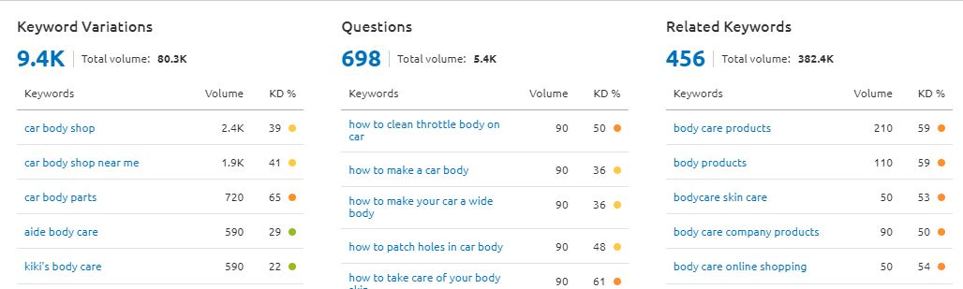
Short-Tail & Long-Tail Keywords (Cont.)
Hair Care
Body Care

Slide 8
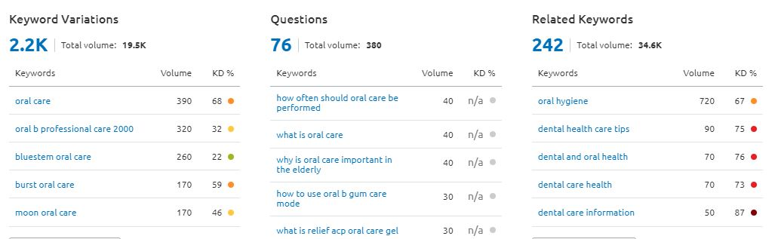
Short-Tail & Long-Tail Keywords (Cont.)
Oral Care

Slide 9
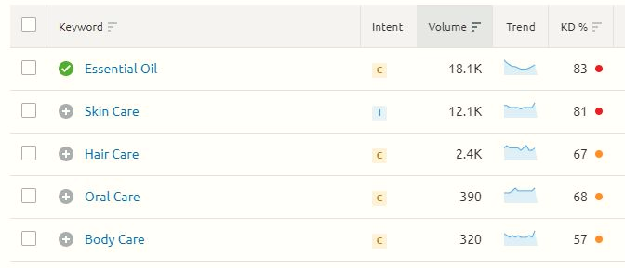

Keyword Volume & Difficulty

Slide 10
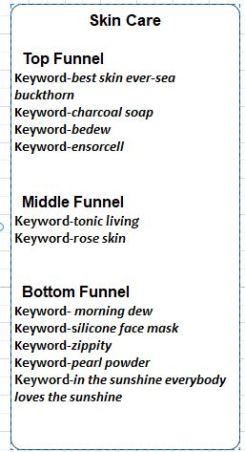
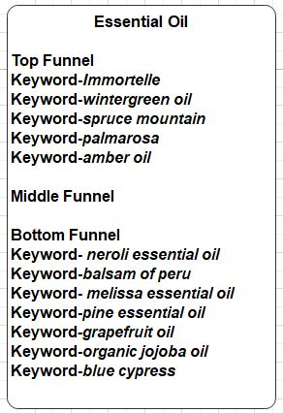
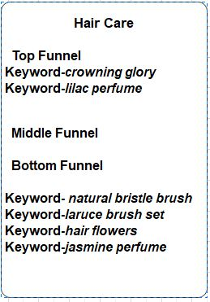
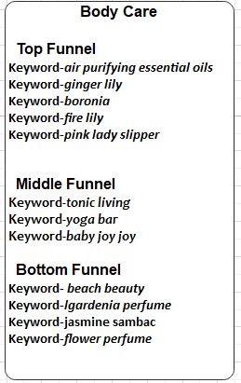
Keyword List – Topic Clusters

Slide 11
Benefits of Keyword Optimization
Qualified traffic of the specific site: For qualified traffic, when a searcher search the site must optimize the keywords what they are searching for. Example: Best skin care, popular essential oil, organic hair oil for women etc.
Data traffic potential: Analysing the market popularity of keywords can help to boost the site of a potential online shopping. Example: Hair care products, young living essential oils etc.
Effective content: This will connect with potential customers and address their needs by optimized keywords into the web content. Example: Natural tone, real beauty, signature skin, easy breath, nature oil etc.
Understanding the user behaviour: Analysing the keywords that customers use in their searching, get an idea of their needs and how to serve those needs. Example: Top selling essential oils, Best skin products for women, Top reviewed hair care products etc.

Slide 12
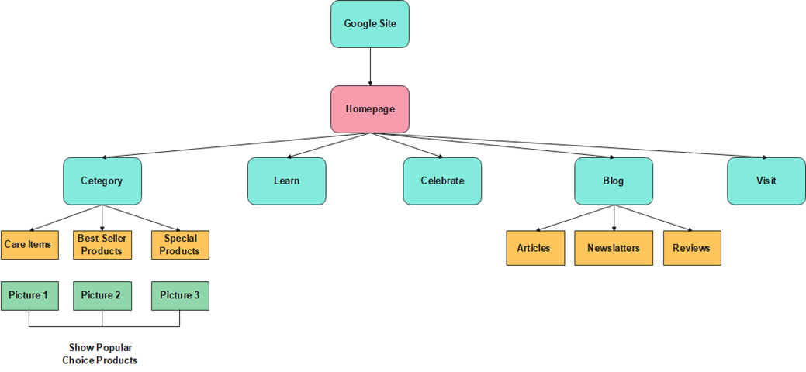
Site Architecture Diagram
Recommended Site Improvements:
In the Category page, sort all the page link by their category. Show the most popular choice products in the sorted link pages. In the top navigation area make another menu “Blog”, which contains the article, newsletters, reviews of the products.

Slide 13
Meta Data Updates Using HTML
Example 1:
<head> <meta charset="UTF-8"> <meta name="Page description" content="Skin Care Sites"> <meta name="keywords" content="best skin ever-seabuckthorn, charcoal soap, ensorcell"> <meta name="author" content="Nazia Rothy"> <meta name="viewport" content="width=device-width, initial-scale=1.0"> </head>
Example 2:
<head> <meta charset="UTF-8"> <meta name="Page description" content="Essential Oil"> <meta name="keywords" content="Immortelle, wintergreen oil, palmarrosa, amber oil"> <meta name="author" content="Nazia Rothy"> <meta name="viewport" content="width=device-width, initial-scale=1.0"> </head>

Slide 14
Meta Data Updates Using HTML (Cont.)
Explanation:
This is the demo layout description of HTML page of Living Libations. Here using the meta tags, which are defined the meta data about the HTML document. There are some attributes used in the demo layout of HTML documents. Detail Description is given below:
Attribute | Value | Description
Charset | Character_Set | Encoding the HTML documents character.
Name | Author Viewport Keywords Description | Specifies a name for the metadata.

Slide 15
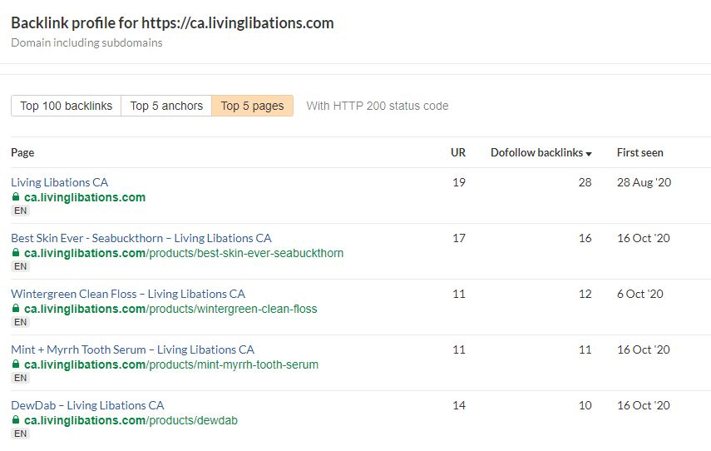
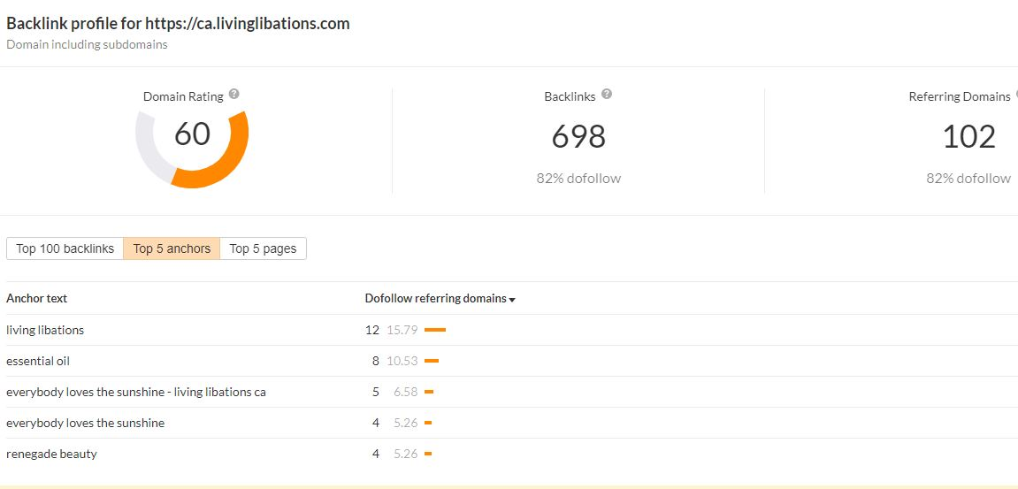
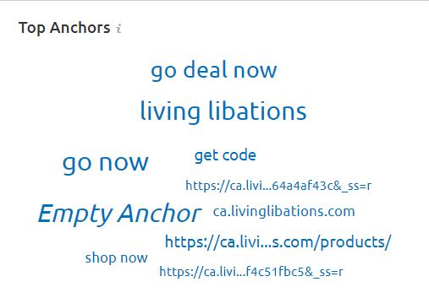
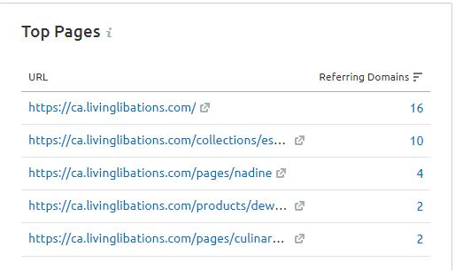
Backlink Strategy

Slide 16
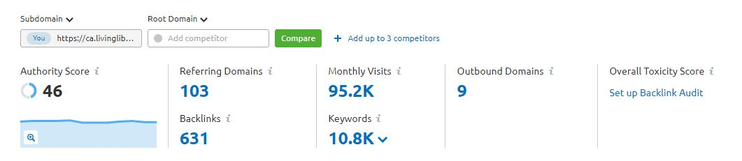
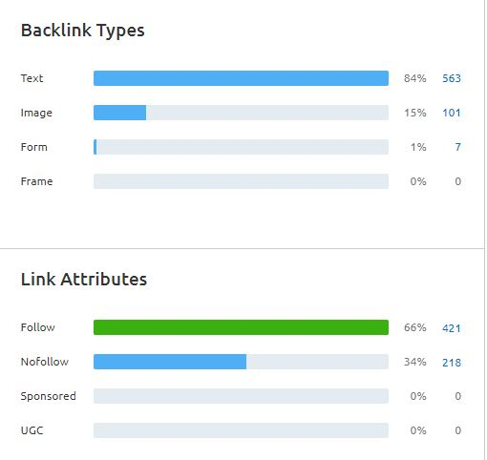
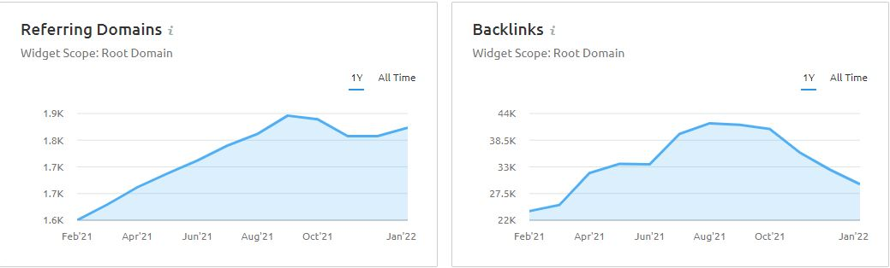
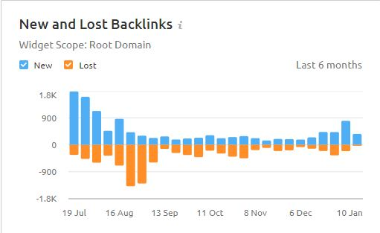
Backlink Strategy (Cont.)

Slide 17
Findings from Backlink Analysis
After analyzing the site's backlinks, it was observed that the backlink type is textual, with an 84 percent success rate. The rate of image backlinks, on the other hand, is smaller than the rate of text backlinks. However, for an ideal website, the ratio is 1:1, which implies it comprises 50% text and 50% graphics. As a result, if this ratio is maintained, more clients will be attracted and traffic will be increased.

Slide 18
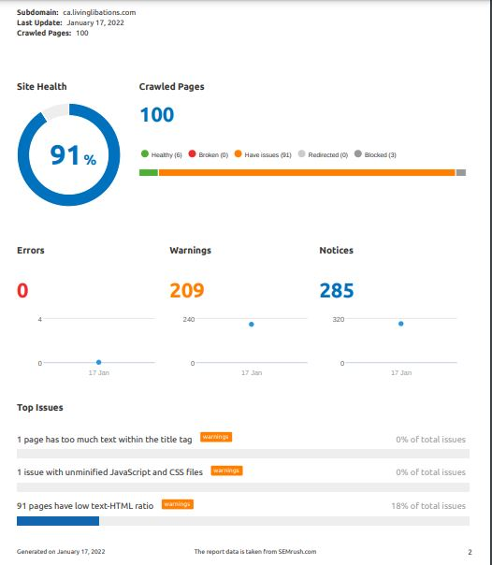
Technical SEO Improvement
Recommended Improvement:
According to SEMrush, the site's health is 91 %. There are three major difficulties here, one of which is that 91 pages have a low text HTML ratio, which suggests that this web page contains an excessive amount of textual HTML code, which may make consumers bored or uninterested in visiting this site. As a result, the site must maintain a balance between image and textual HTML codes.
Moreover, the site performance is 98% and internal linking is 91%. So, for a sophisticated website need to increase the internal linking rate.

